Slide 1
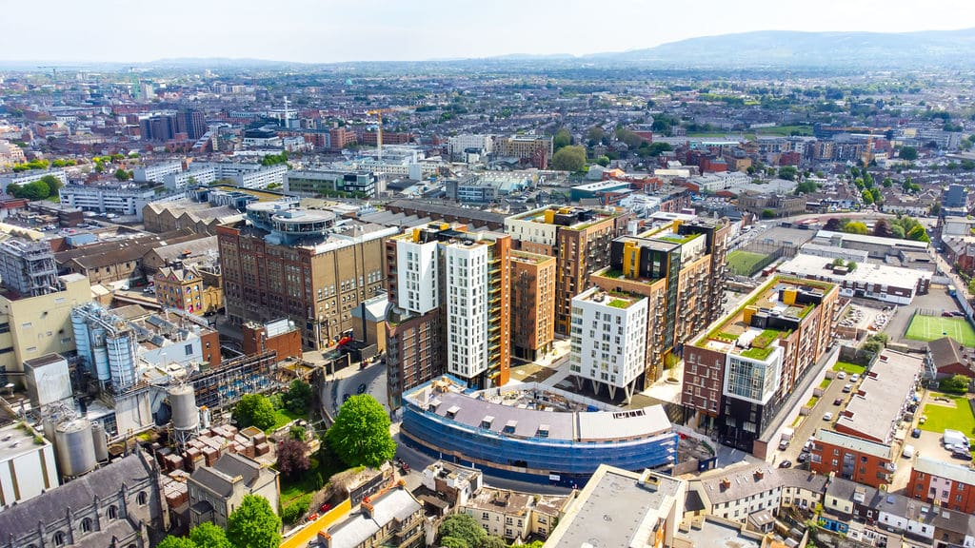
Retail units
Grand Canal Harbour, St. James Gate, Dublin 8
To let
Property Highlights
Excellent retail opportunities within the new Grand Canal Harbour development.
There is approximately 1,014 sq.m (10,913.6 sq.ft) of ground floor retail space available currently divided into 5 units.
Unit 1 extends to approx. 154 sq. m (1657.6 sq. ft).
Unit 2 extends to approx. 363 sq. m (3,907 sq. ft).
Unit 3 extends to approx. 127 sq. m (1,367 sq. ft).
Unit 4 extends to approx. 215 sq. m (2,314 sq. ft).
Unit 5 extends to approx. 155 sq. m (1,668 sq. ft).
Quoting rent available on enquiry.
Property Description
Grand Canal Harbour seamlessly intertwines modern luxury with historic charm nestled in Dublin's bustling dockyard.
The development houses 482 one-bedroom and 114 two-bedroom apartments spanning six blocks amidst a vibrant urban landscape.
Designed with community in mind, over half of our space is dedicated to public areas with 7,000 sqm, of communal spaces, fitness areas, playgrounds, and retail offerings.
Contact
Amanda Dzerve
+353 86 066 2841
amanda.dzerve@cushwake.com
Peter Love
+353 1 639 9612
peter.love@cushwake.com

Slide 2
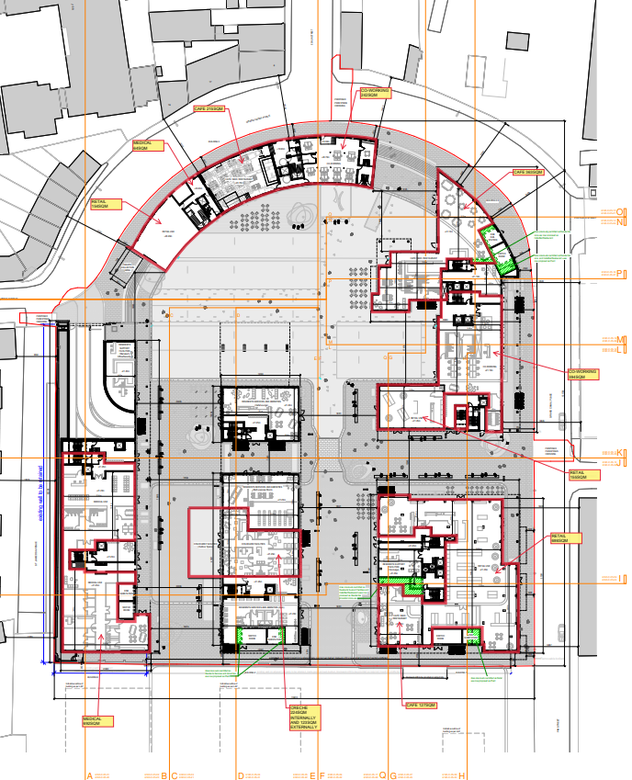
Grand Canal Harbour, St. James Gate, Dublin 8

Slide 3
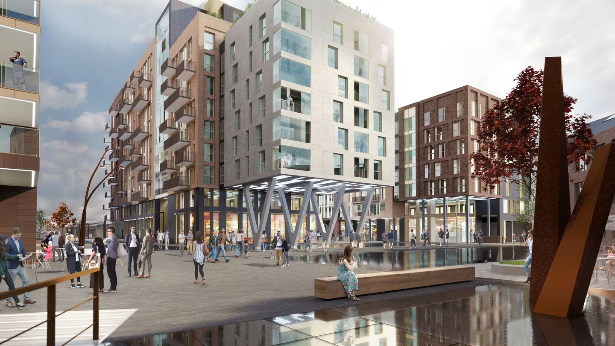
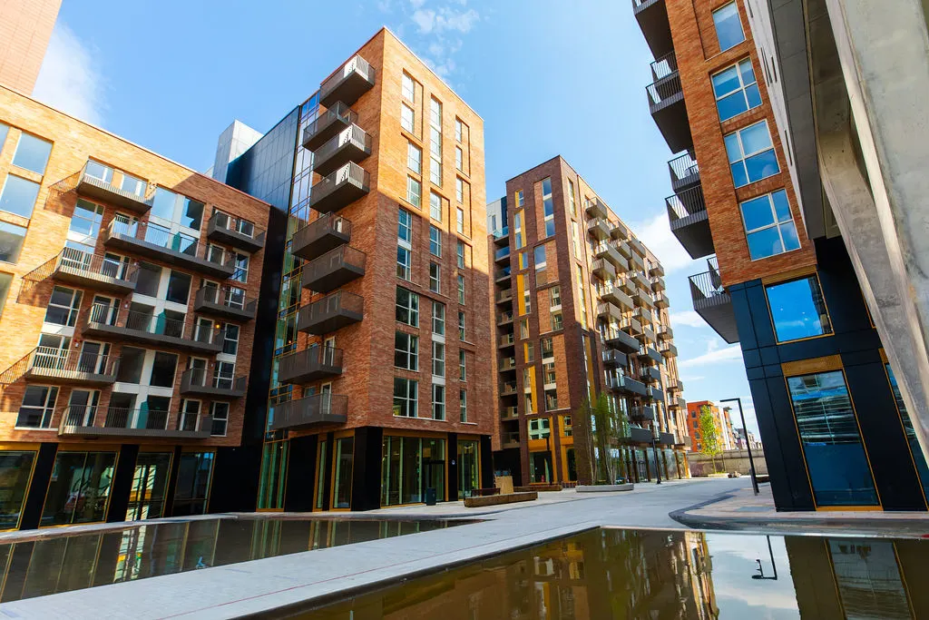
Grand Canal Harbour, St. James Gate, Dublin 8

Slide 4
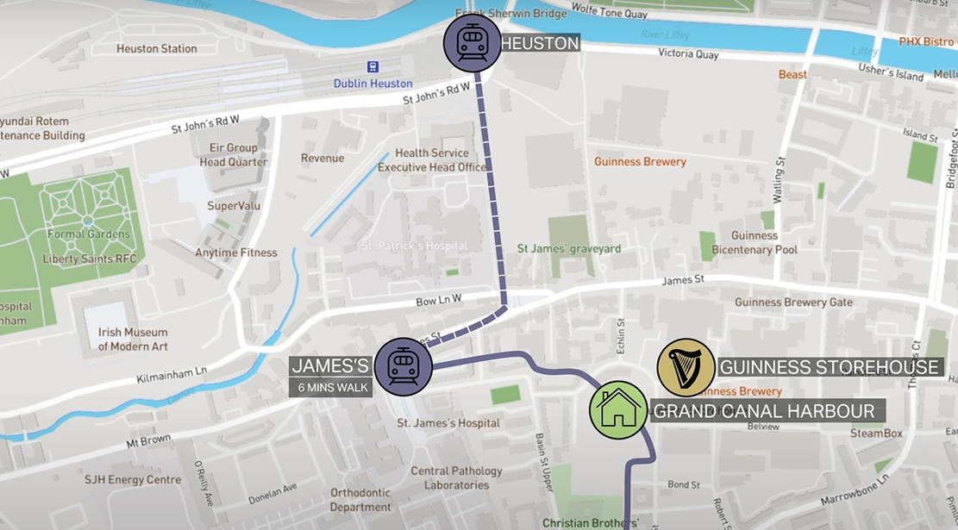
Grand Canal Harbour, St. James Gate, Dublin 8
Location
Neighboring the Guinness Storehouse (and its famous Gravity Bar), the site is centered between some of the country’s landmark institutions, with Dublin City Centre a short walk away, and excellent public transport options.
Close to two stops of the Luas Red line, Heuston Station as well as multiple Dublin Bus routes and Dublin bikes stations, the development also has good road connections to the M50 and the N4. Dublin Airport is a 30-minute drive away.
Schedule of Accommodation
Unit | SQM | SQFT
1 | 154 | 1657.6
2 | 363 | 3,907
3 | 127 | 1,367
4 | 215 | 2,314
5 | 155 | 1,668
Cushman & Wakefield
2 Cumberland Place
Fenian Street
Dublin 2
Ireland
Quoting Rent
The quoting rent is available on enquiry.
BER: Exempt

